Slide 1




CUSTOMER CHURN PREDICTION FOR TELCO COMPANY
Presented by: Trần Chí Tâm

Slide 2
Problem Statement
BUSINESS ISSUES
High Customer Abandonment Rates for Telecom Services
Missing Tools Expected to Stop Working Soon
Lower Total Revenue Leads to Customer Loss
IMPACT:
Higher cost of acquiring new customers
Directly affects revenue and profits
Lost opportunities for cross-selling and up-selling

Slide 3
Project Objectives
Predict Customer Churn: Build ML model (accuracy >80%) to classify churn risk.
Identify Key Drivers: Analyze features (contract, tenure, charges…) that impact churn most.
Support Retention Strategy: Provide insights for campaigns to reduce churn rate and increase CLV.
Improve Decision-Making: Enable data-driven actions, optimize marketing costs and boost customer satisfaction.

Slide 4
PROJECT WORKFLOW
PHASE 1: DATA ACQUISITION
Kaggle Dataset: Telco Customer Churn
7,043 customers
21 features
Target: Churn (Yes/No)
PHASE 4: MODEL DEVELOPMENT
Machine Learning (telco_modeling.ipynb)
Feature engineering
Model training & validation
Hyperparameter tuning
Model evaluation
PHASE 2: DATA PREPROCESSING
Python Preprocessing (telco_preprocessing.ipynb)
Data cleaning & validation
Missing value handling
Data type conversion
Export: telco_clean.csv
PHASE 5: PREDICTION SYSTEM
Production Pipeline
save_model.py: Model persistence
predict_churn.py: Automated predictions
Real customer data (sample.csv)
Business insights & recommendations
PHASE 3: EXPLORATORY ANALYSIS
Power BI EDA
Import telco_clean.csv
Interactive dashboard creation
Customer behavior analysis
Business insights discovery

Slide 5

DATA OVERVIEW
SOURCE: Kaggle - Telco Customer Churn
DATASET CHARACTERISTICS:
• Size: 7,043 customers
• Features: 21 variables
• Target: Churn (Yes/No)
• Industry: Telecommunications
FEATURE BREAKDOWN:
Demographics:
• Gender, Age, Partner, Dependents
Services:
• PhoneService, MultipleLines
• InternetService, OnlineSecurity
• OnlineBackup, DeviceProtection
• TechSupport, StreamingTV, StreamingMovies
Billing:
• Contract, PaperlessBilling
• PaymentMethod, MonthlyCharges, TotalCharges
Usage:
• Tenure (months of service)

Slide 6
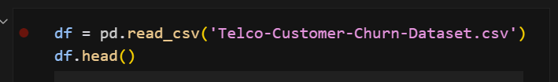
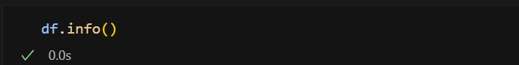
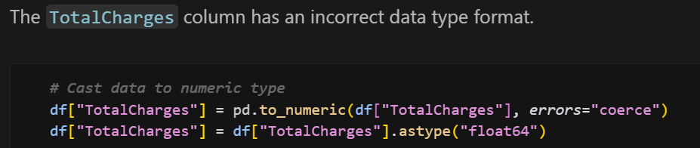
DATA PREPROCESSING
1. DATA LOADING & INSPECTION
Load raw data from Kaggle
Check data types and missing values
Identify data quality issues

Slide 7
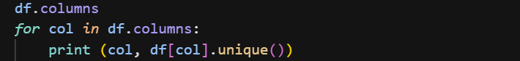
DATA PREPROCESSING
2. DATA CLEANING
Handle missing values
Remove duplicates
Check data consistency

Slide 8
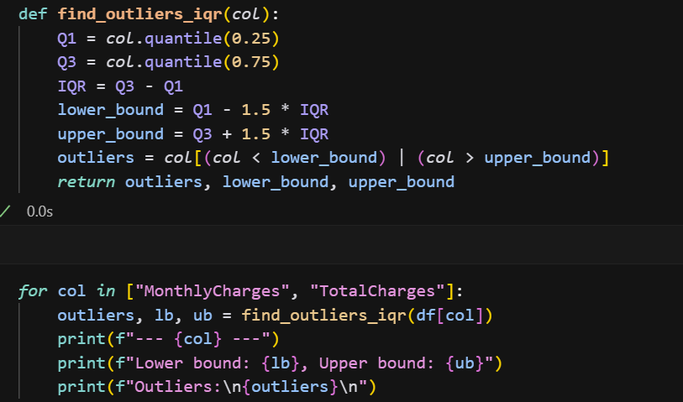
DATA PREPROCESSING
3. DATA VALIDATION
Check for outliers

Slide 9
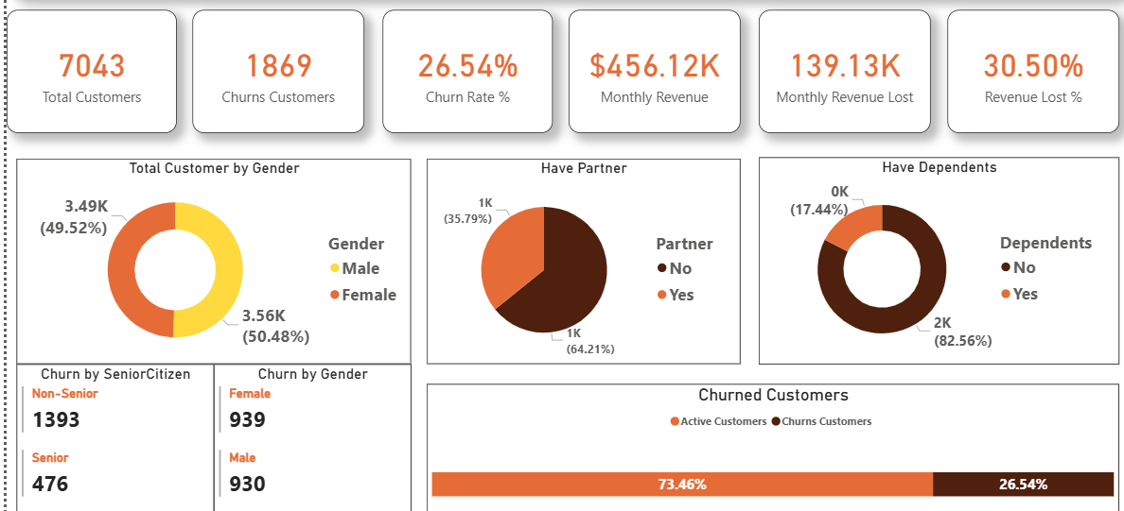
EDA POWER BI
Churn Overview – Key Insights
High Churn: 26.54% of Customers → Loss of ~30,5% Revenue/Month ($139K).
Gender: Nearly 50/50 → Not a Key Factor.
Partners: 64% of Customers Don’t Have a Partner → Minor Impact.
Dependents: 82.6% of Customers Don’t Have a Dependent → This is the Most Churning Group.
Churn focuses on the group with no Partners, no Dependents – single customers are the biggest leak point

Slide 10
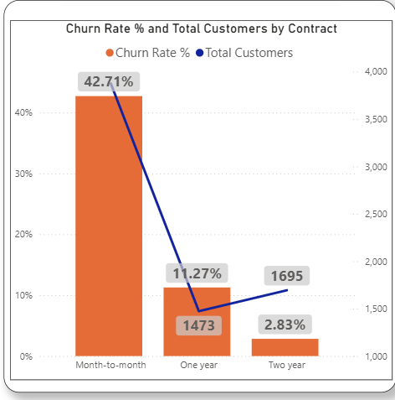
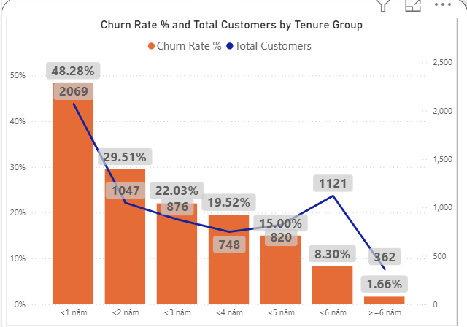
EDA POWER BI
Month-to-month: Extremely high churn of 42.7% → riskiest group.
One year: Sharp drop to 11.27%.
Two year: Almost stable, only 2.83% churn.
Insight: The longer the contract, the more loyal the customer.
< 1 year: Nearly half of customers (48.28%) leave → riskiest period
1–2 years: Churn drops to ~30%.
3–5 years: 15–22% → has gradually stabilized.
> 6 years: Churn is only 1.7%, almost “long-term loyal customers”.
Insight: The first 12 months are very risky, nearly 50% of customers leave. If you keep them for the first year, the chance of keeping them for the long term is very high.

Slide 11
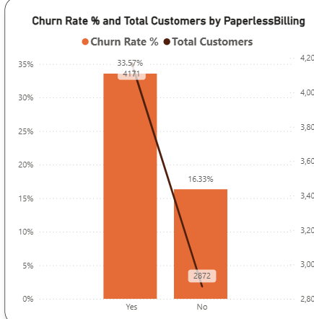
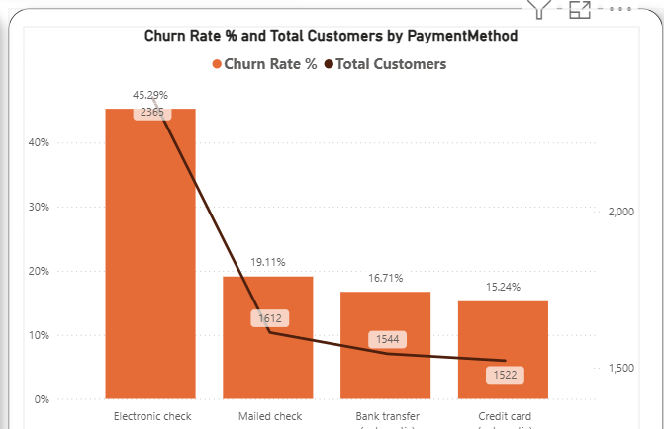
EDA POWER BI
Customers using e-invoices have a high churn rate (33.6%) which is almost twice as high as customers using paper (16.3%).
This group may find it difficult to control costs or less committed → more likely to leave.
Electronic check has the highest churn (45%) → high risk group.
Other methods are more stable: Mailed check (19%), Bank transfer (16.7%), Credit card auto-pay (15.2%).

Slide 12
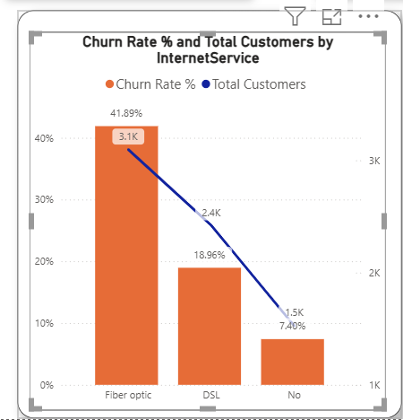
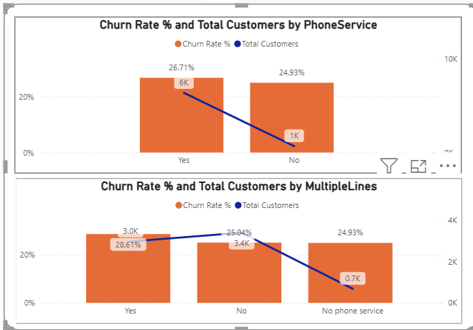
EDA POWER BI
Fiber optic churn is up to 42% even though it is a “better” service package → customers pay more but easily leave. Maybe because of high price, quality does not meet expectations.
DSL churn is lower (19%) → customers are more stable.
Insight: Fiber optic brings high revenue but is also the place where customers are lost the most. Need to improve the experience of this group (eg: improve quality, retain incentives).
Phone Service & Churn
With or without Phone service, churn is ~25–27%.
Insight: Phone service does not affect churn much → should not focus on retention through this channel.
Multiple Lines & Churn
Churn is almost equal (25–29%), regardless of having multiple lines.
Insight: Multiple lines do not make a difference → is not a retention lever.

Slide 13
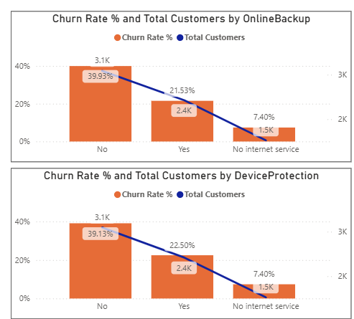
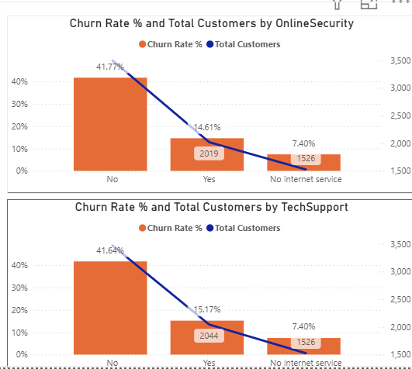
EDA POWER BI
Online Backup
Not used: churn is high ~40%.
With use: churn drops to 21.5%.
Backup helps customers stay engaged, although it is not the strongest factor.
Device Protection
Not used: churn 39%.
With use: churn drops to 22.5%.
Similar impact to backup: with protection service, churn is much lower.
Online Backup
Not used: churn is high ~40%.
With use: churn drops to 21.5%.
Backup helps customers stay engaged, although it is not the strongest factor.
Device Protection
Not used: churn 39%.
With use: churn drops to 22.5%.
Similar impact to backup: with protection service, churn is much lower.

Slide 14
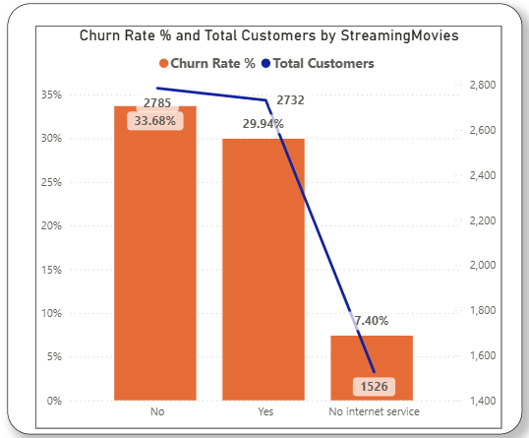
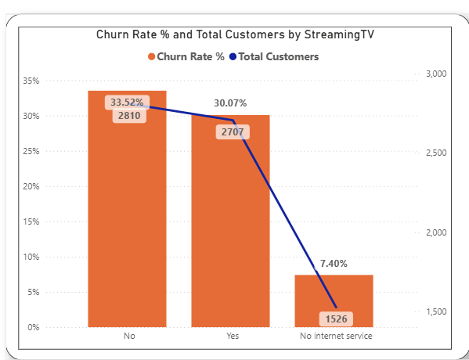
EDA POWER BI
Streaming Movies
Customers who don't use: churn 33.7%.
Customers who use: churn drops slightly to 29.9%.
Watching movies online helps reduce churn a little, but doesn't make a big difference.
Streaming TV
Customers who don't use it: churn 33.5%.
Customers who use it: churn ~30%.
Like streaming movies, having a TV service helps reduce churn, but it's not the deciding factor.

Slide 15



CONCLUSION
Currently, more than 1/4 of customers are leaving, losing nearly 30% of monthly revenue.
Short-term contracts and customers under 1 year are at the highest risk.
Fiber optic brings in a lot of revenue but also has a high churn rate.
Customers using additional services such as Online Security, Tech Support are significantly less likely to leave.
Electronic check and Paperless billing are associated with high churn, need to be adjusted.
Entertainment services such as Streaming TV/Movies are not affected much.

Slide 16
PROPOSED ACTIONS
Retain first 12 months
New customer incentives (3–6 month discount, service bundle).
Loyalty program when reaching 1 year milestone.
2. Promote long-term contracts
Attractive promotions for 1–2 years instead of month-to-month.
Bundle package: internet + security/support at good price.
3. Fiber optic group care
Improve service quality, separate hotline for high-paying customers.
Offer add-ons (backup, device protection) to increase loyalty.
4. Change payment methods
Encourage auto-pay/credit card → lower churn.
Gradually reduce dependence on electronic check.
5. Invest in value-added services (add-ons)
Promote Online Security & Tech Support because of its clear retention impact.
Position add-ons as “insurance” for customers.

Slide 17

MACHINE LEARNING METHODS FOR CHURN PREDICTION
Objective: Build a model to predict customers at risk of churning
Method: Compare 3 algorithms: Random Forest, Logistic Regression, XGBoost
Evaluation: Accuracy, AUC, Precision, Recall, F1-Score
Implementation: Production-ready prediction system

Slide 18

LABEL ENCODING (Binary Variables → 1/0)
Label Encoding (1/0): Partner, Dependents, PhoneService, Churn, PaperlessBilling, Gender (6 features)
One-Hot Encoding: MultipleLines, Internet/Online services, Contract, PaymentMethod (10 features → 30 cols)
Feature Scaling: MonthlyCharges, TotalCharges, Tenure → MinMax [0–1]
Train-Test Split (80/20): 5,634 train | 1,409 test, stratified, random_state=42
Result: 46 features, no missing, clean dtypes
FEATURE ENGINEERING & DATA PREPARATION

Slide 19
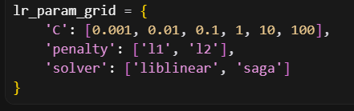
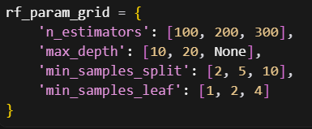
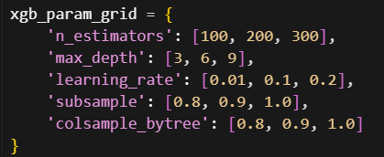
Model Parameter Optimization
1. Logistic Regression Parameter Grid:
Why tune hyperparameters ?
Goal: Find the optimal parameter set for each model
Benefit: Significantly improve prediction performance
Methods: GridSearchCV and RandomizedSearchCV
2. Random Forest Parameter Grid:
Tuning Results:
3. XGBoost Parameter Grid:
Logistic Regression: C=100, penalty='l2', solver='liblinear'
Random Forest: n_estimators=200, max_depth=10, min_samples_split=5
XGBoost: n_estimators=300, max_depth=3, learning_rate=0.01

Slide 20
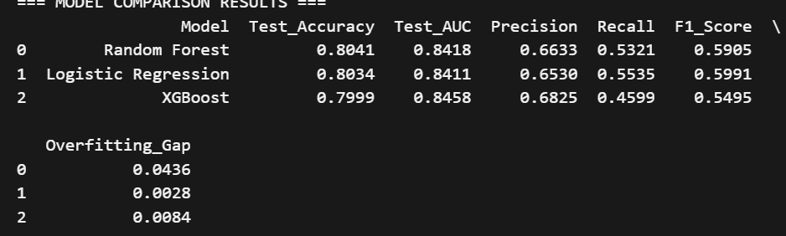
COMPARE THREE MODELS
Evaluation Methodology
5 Key Metrics to Evaluate Model Performance:
Accuracy: Overall Correct Prediction Rate
AUC: Ability to Distinguish Between Churning and Non-Churning Customers
Precision: Proportion of Customers Who Actually Churn Out of Those Predicted to Churn
Recall: Proportion of Churning Customers Correctly Detected
F1 Score: Balance Between Precision and Recall
Performance Results
Comment
Random Forest: Has the highest accuracy but the most overfitting
Logistic Regression: Best balance between metrics, most stable
XGBoost: Has the highest AUC and Precision but the lowest Recall

Slide 21
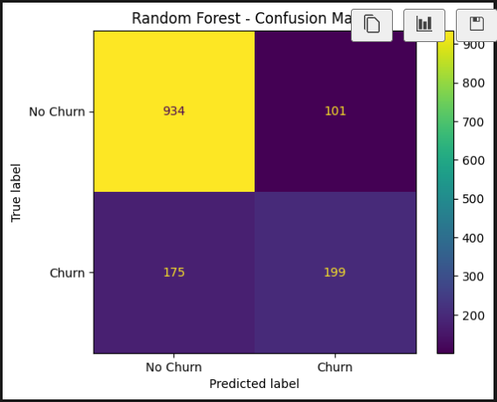
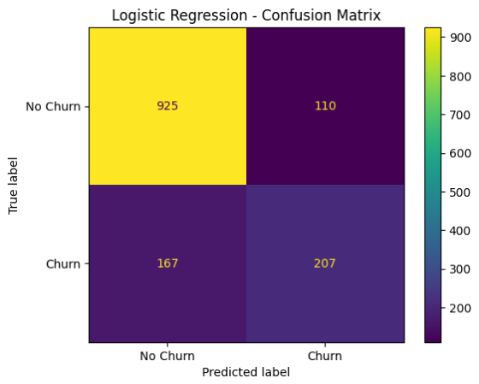
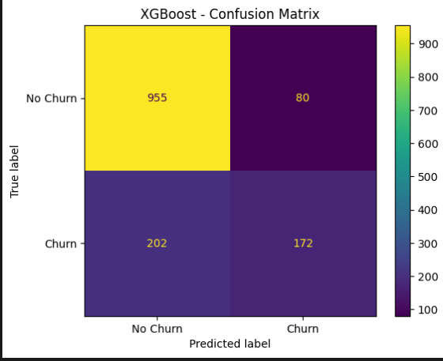
CONFUSION MATRIX OF MODELS
Random Forest Confusion Matrix:
Logistic Regression Confusion Matrix:
XGBoost Confusion Matrix:
Compare False Negatives (Most Important):
Random Forest: 175 undetected churn customers
Logistic Regression: 167 undetected churn customers
XGBoost: 201 undetected churn customers
Compare False Positives:
Random Forest: 104 misidentified non-churn customers
Logistic Regression: 114 misidentified non-churn customers
XGBoost: 83 misidentified non-churn customers
Conclusion:
Logistic Regression has the lowest False Negatives → Detects the most churned customers
XGBoost has the lowest False Positives → Least confusion
Random Forest balances the two metrics

Slide 22



SELECTED MODEL
WHY CHOOSE LOGISTIC REGRESSION?
Lowest Overfitting: 0.28% → most stable
Highest F1: 59.91% → Precision–Recall balance
Highest Recall: 55.35% → detects most churns
Good AUC: 84.11% → clearly distinguishes churns
Business Benefits
Easy to understand, explain to stakeholders
Fast, compact, easy to maintain
Easy to deploy, low cost
Overall Comparison
Logistic Regression: 81.26% (F1: 59.91%, Recall: 55.35%)
Random Forest: 80.31% (High Overfitting 4.36%)
XGBoost: 80.19% (Low Recall 45.99%)

Slide 23
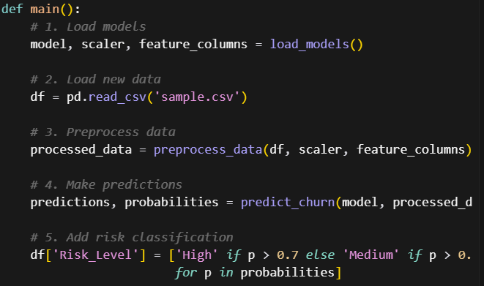
MODEL STORAGE AND DEPLOYMENT
Purpose
Save model + scaler, feature columns for reuse
Ensure consistent predictions, easy to deploy
Process
Train & save (save_model.py)
Train with best params
Save 3 .pkl files (model, scaler, features)
Check successful loading
Predict churn (predict_churn.py)
Load .pkl files
Preprocess new data using the same pipeline
Return results:
Churn_Prediction: 0/1
Churn_Probability: 0–1
Risk_Level: Low (<30%), Medium (30–70%), High (>70%)
Export sample_with_predictions.csv

Slide 24
PRACTICAL APPLICATIONS
CHURN PREDICTION ON SAMPLE FILE
Sample File Introduction:
Total Customers: 20 Customers
Data Source: Representative Sample from Main Dataset
Characteristics: Diverse in Tenure (1-72 Months), Contract Type, and Service
Sample Characteristic Distribution:
Contract Type:
Month-to-month: 5 Customers (25%)
One Year: 6 Customers (30%)
Two Year: 9 Customers (45%)
Internet Service:
DSL: 10 Customers (50%)
Fiber Optic: 10 Customers (50%)
Tenure Range:
<12 Months: 4 Customers (20%)
12-36 Months: 6 Customers (30%)
>36 Months: 10 Customers (50%)

Slide 25
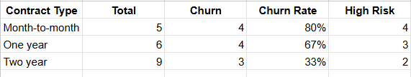
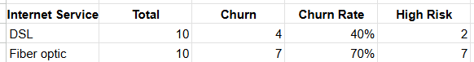
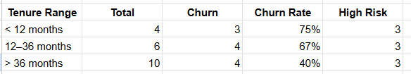
PREDICTION RESULTS
Overview Statistics:
Total Customers: 20 Customers
Predicted Churn: 11 Customers (55%)
Risk Distribution:
High Risk: 9 Customers (45%)
Medium Risk: 2 Customers (10%)
Low Risk: 9 Customers (45%)

Slide 26
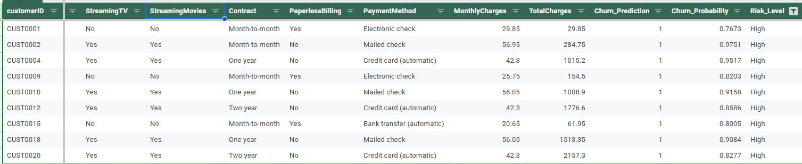
RISK GROUP SOLUTIONS
HIGH RISK CUSTOMERS (9 CUSTOMERS - 45%)
Immediate Action:
Call within 24 hours: Personal Account Manager
Special Offer: 25-30% Discount for 3-6 Months
Service Upgrade: Free Online Security + Tech Support
Contract Conversion: Offer to switch from Month-to-month to 1-2 years
Specific Solutions:
Month-to-month Customers: Offer to switch to long-term contracts
Fiber optic Customers: Optimize speed, in-depth technical support
Electronic check Customers: Encourage to switch to automatic payment
New Customers (<12 months): Special onboarding program
Monitoring: Daily, weekly progress reports
Tracking: Daily, weekly progress reports

Slide 27
RISK GROUP SOLUTIONS
MEDIUM RISK CUSTOMERS (2 CUSTOMERS - 10%)
Actions Within 48h:
Personalized Email: Custom Content Based on Customer Characteristics
Moderate Offer: 10-15% Discount for 2-3 Months
Service Enhancement: Priority Technical Support
Feedback Survey: Collecting Opinions for Improvement
Specific Solution:
CUST0016 (68.49%): Email + 15% Discount + Technical Support
CUST0017 (57.25%): Feedback Survey + Special Support for Seniors
Follow-up: Weekly, Evaluate Performance After 2 Weeks

Slide 28
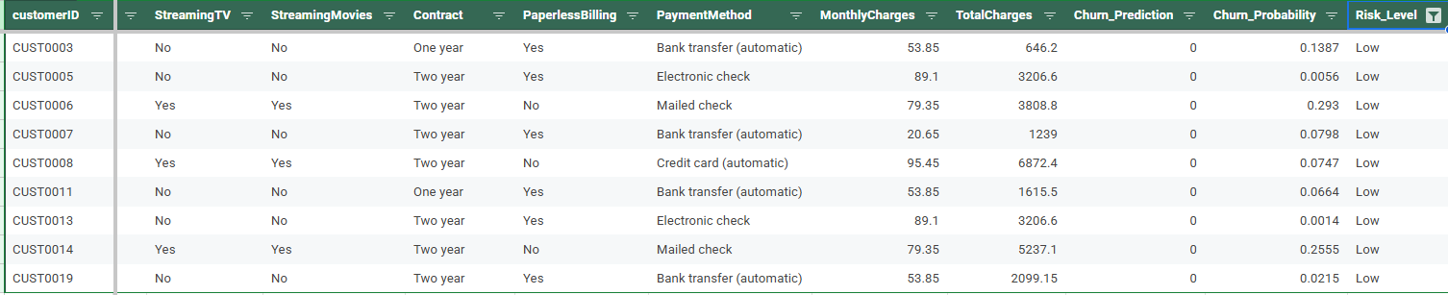
RISK GROUP SOLUTIONS
LOW RISK CUSTOMERS (9 CUSTOMERS - 45%)
Retention Actions:
Loyalty program: Maintain current offers
Email marketing: Information about new services, updates
Referral incentives: Rewards for referring friends
Satisfaction survey: Survey every 6 months
Specific Solutions:
Two-year customers: Early renewal offers, service upgrades
Long-term customers (>36 months): VIP program, special offers
Bank transfer/Credit card customers: Maintain, no change
Monitoring: Monthly, satisfaction score assessment

Slide 29

THANK YOU

